Slide 1
ContinUous Architecture
Architecting for Continuous Delivery
Robert Höglund Senior IT Solution Architect

Slide 2

Why?

Slide 3
Background
Agile Teams that want full autonomy
IT organization that want to review & approve almost everything
Turf wars between different teams and different parts of the organisations
Scaling issues

Slide 4

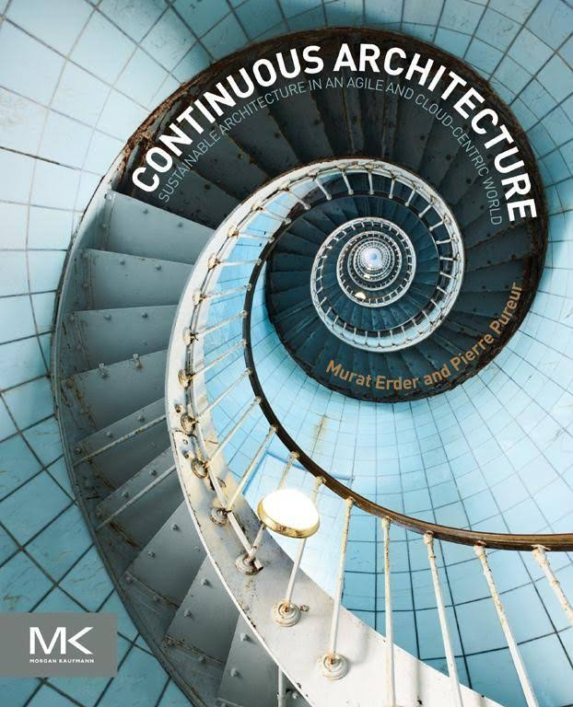

a new approach to Architecture
The current trend in the industry is away from traditional Enterprise Architecture.
There is a need for an architectural approach that can encompass Continuous Delivery
While providing the Continuous Delivery Process with a broader architectural perspective.
We call this approach “Continuous Architecture”.
This is about using the appropriate tools to make the right decisions and support Continuous Delivery, Continuous Integration and Continuous Testing.
Pierre Pureur
Chief Architect at Travelers
Murat Erder
Chief Technology Officer,
Infrastructure and Shared Technology Services Deutsche Bank

Slide 5
What is traditional Enterprise Architecture?

Slide 6
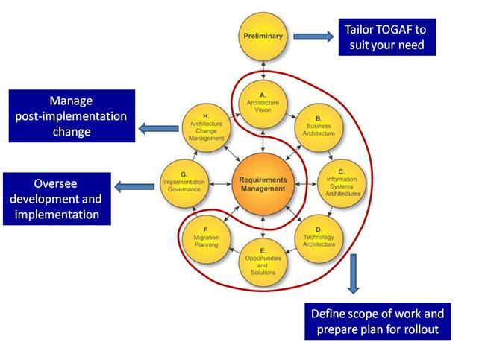
Enterprise Architecture Frameworks
TOGAF, Zachman, RUP 4 + 1
Designed for Waterfall
Big Design Up-Front (BDUF)
Design responsibility outside teams
Review & Approve Everything
Results in long and slow feedback loops

Slide 7
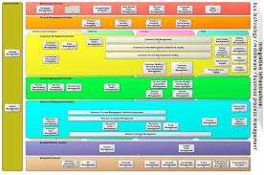
Reference Models
Functional decomposition
Favour monolithic solutions
What about Quality Attributes?

Slide 8
Enterprise ArcHitecture Mission
To Envision an organization that includes the strategic and operational changes that leaders require and demand
To Guide changes to the structure of the organization, and the actions of the business units themselves, so that the vision becomes reality.
To achieve the right balance between IT efficiency and business innovation
To ensure that the needs of the organization for an integrated IT strategy are met, permitting the closest possible synergy across the extended enterprise
A more efficient business operation
A more efficient IT operation
Better return on existing investment, reduced risk for future investment

Slide 9
Why Agile And Continuous Delivery?

Slide 10
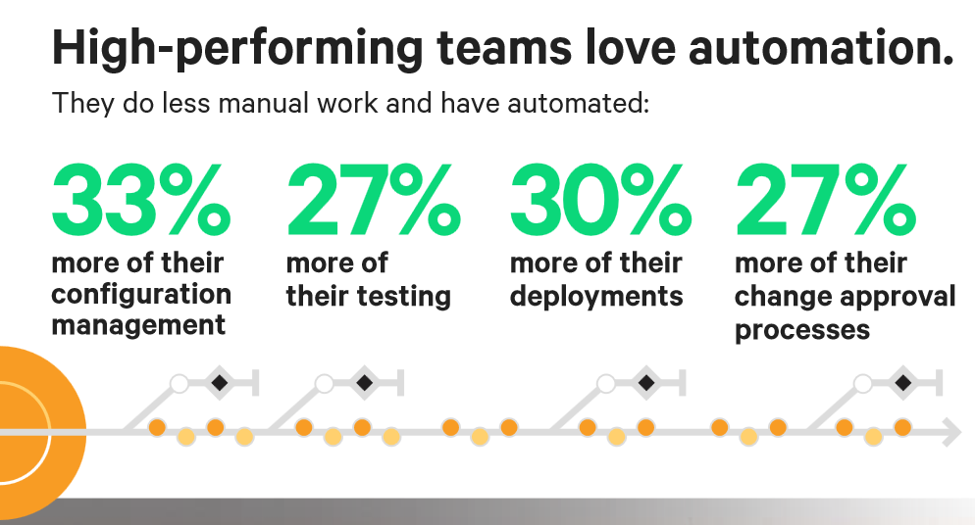
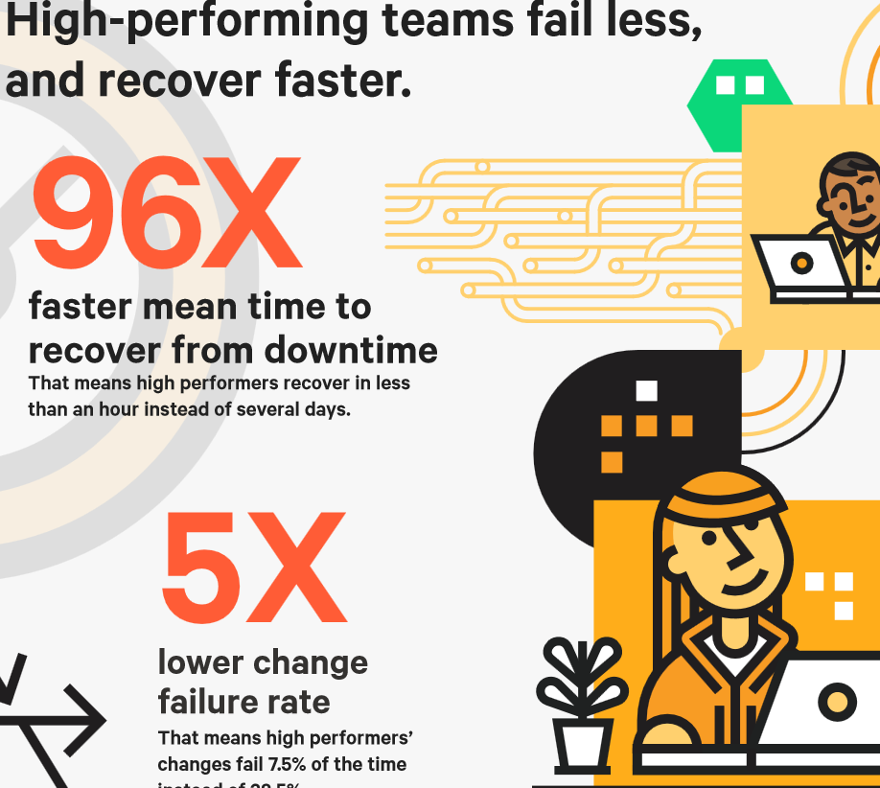
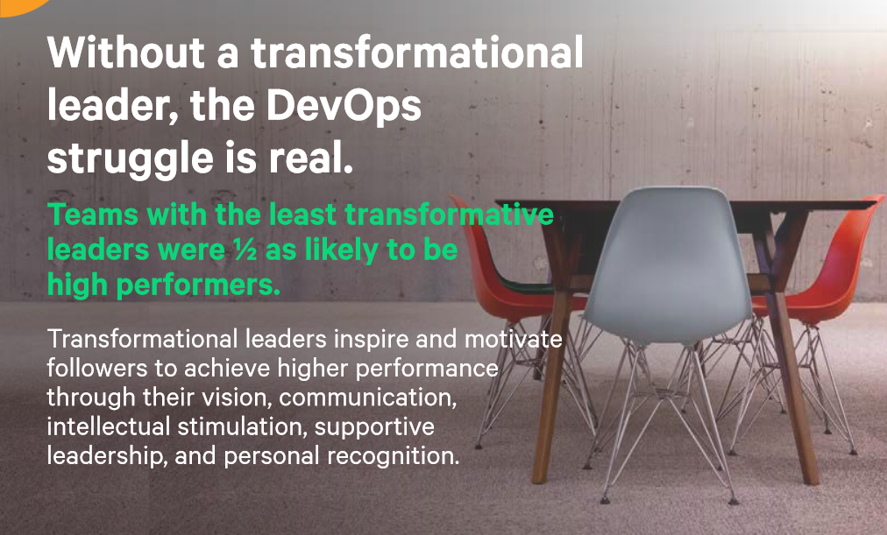

Economy

Slide 11
WHAT is Agile, Emergent Design & Continuous Delivery

Slide 12
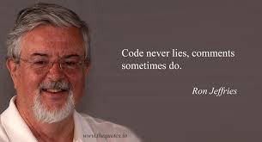
Agile Manifesto: Emergent Design
The best architectures, requirements, and designs emerge from self-organizing teams.
If the program is to stay alive, design must change, it must emerge. If this is to happen, the team must do it. If the team is to do it, they must be organized to do it. The best way to organize is in response to the moment. To respond in the moment, you need to be in the moment.
A self-organizing team is the best way to keep the team in the moment, the best way to respond to the moment, the best way to improve the design in the moment it needs it.
The best results emerge from self-organizing teams.

Slide 13

Continuous Delivery - Definition
The ability to get changes – features, configuration changes, bug fixes, experiments – into production or into the hands of users safely and quickly in a sustainable way.

Slide 14
Conflicts between Traditional Enterprise architecture AND Agile Practices

Slide 15

Myths about Agile Architecture
Agilists don’t “do architecture”
Agilists start coding right away
Agilists don’t follow enterprise architecture strategies
Agilists don’t model
Agilists don’t document

Slide 16

Myth about Agile – Wild West Culture

Slide 17




Agile Team – BDUF - Traditional ways of working

Slide 18
Agile Architecture in Practice

Slide 19

Realities About successful Agile Architecture
Architecture is so important agilists address it throughout the entire lifecycle
Disciplined agilists invest in some up front envisioning
Discipline agilists work closely with enterprise professionals
Disciplined agilists explicitly model in a lightweight manner throughout the lifecycle.
Disciplined agilists write deliverable documentation continuously

Slide 20
What about Autonomy?

Slide 21

Autonomy & Self organizing teams
Selforganizing Teams
As far as possible
Autonomy
Operational decisions
Mission
Defines boundaries to autonomy
Shared Nothing - Does not scale well! Where is your supply line?

Slide 22

Who’s in command
What about Strategical and Tactical decisions?
Who designs the battle plan?
Who takes the decisions on the ground?

Slide 23
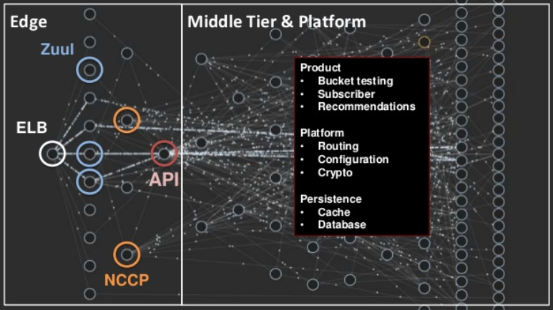
Do we need Enterprise level architecture?
Handling traffic at Netflix

Slide 24
What IS Continuous Architecture?

Slide 25
Architecture Vision - Continuous Architecture
With the adoption of Agile methodologies and Continuous Delivery there is a need for a new approach to (enterprise) architecture
An approach that not encompas Continuous Delivery (on the enterprise level)

Slide 26
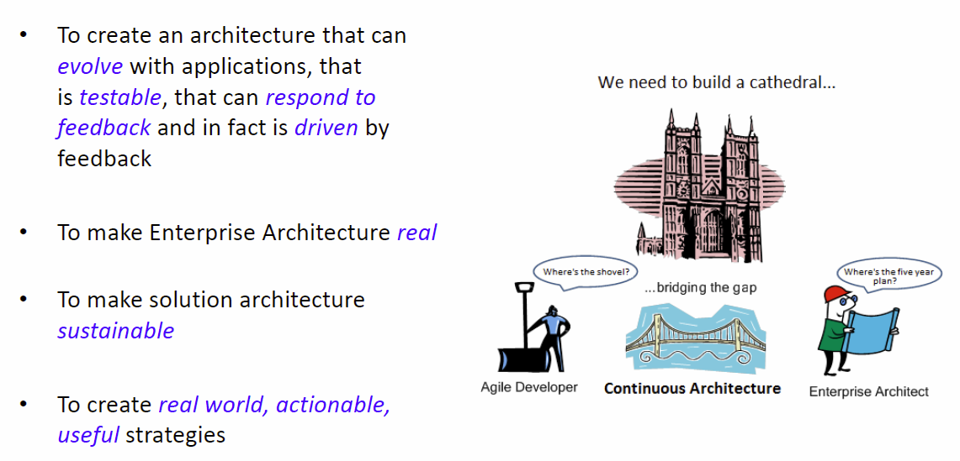
Continuous Architecture

Slide 27
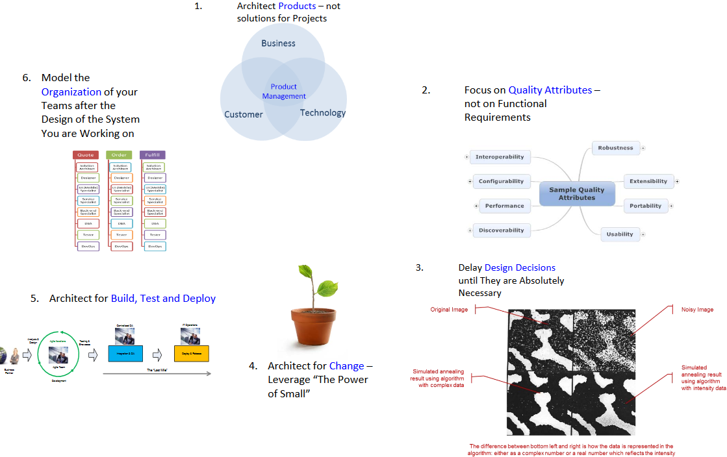
ContInuous Architecture - Principles

Slide 28

Sustainable development
Architecture that meets the needs of the present without compromising the ability of future generations to meet their own needs

Slide 29
What’s the difference between emergent design and continuous architecture?

Slide 30
EmergEnt Design & Continuous Architecture
“With emergent design, a development organization starts delivering functionality and lets the design emerge. Development will take a piece of functionality A and implement it using best practices and proper test coverage and then move on to delivering functionality B. Once B is built, or while it is being built, the organization will look at what A and B have in common and refactor out the commonality, allowing the design to emerge. This process continues as the organization continually delivers functionality. At the end of an agile release cycle, development is left with the smallest set of the design needed, as opposed to the design that could have been anticipated in advance.”
”There are several key aspects to continuous architecture. Disciplined agile teams will perform architecture envisioning at the beginning of a project to ensure that they get going in the right direction. They will prove the architecture with working code early in construction so that they know their strategy is viable, evolving appropriately based on their learnings. They will explore new or complex technologies with small architecture spikes. They will explore the details of the architecture on a just-in-time (JIT) basis throughout construction, doing JIT modeling as they go and ideally taking a test-driven-development (TDD) approach at the design level.”

Slide 31
Agile Teams need to be Enterprise Aware

Slide 32
Disciplined Agile Delivery Enterprise Awareness
The Disciplined Agile Delivery (DAD) 1.x framework purposefully included the philosophy of enterprise awareness
The need for agile delivery teams to look beyond their immediate needs and consider the long-term needs of their organization.
A common example of this is to work closely with your organization’s enterprise architects.
The Disciplined Agile 2.0 framework, explicitly addresses Enterprise Architecture so that organizations may see how it fits into the overall strategy to build an agile organization.

Slide 33
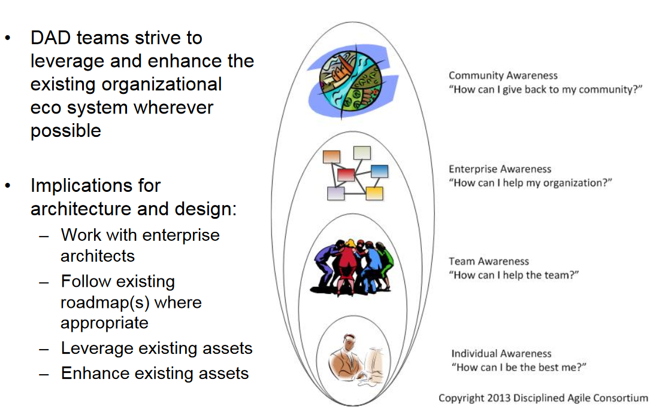
DAD Teams Are ”Enterprise Aware”

Slide 34
How do you work with architecture in an agile process?

Slide 35
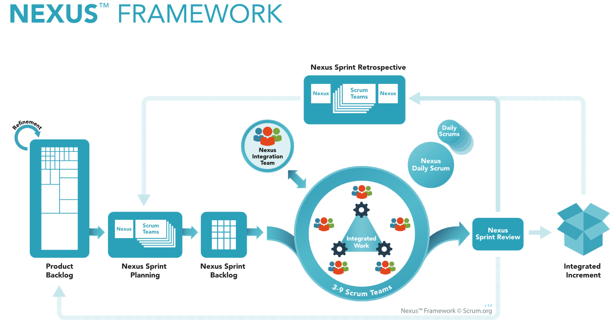

Architecture IN nexus FrameworK – NIT TeaM
Work is integrated frequently, at least once a day, to identify and resolve dependencies.
If people are working in different branches and they haven't integrated into the code base and aren't delivering, you don't know that you have resolved the dependencies
https://www.scrum.org/resources/nexus-framework-poster
Up to 9 teams, approximately 100 people
How to scale beyond that?
Ken Schwaber

Slide 36
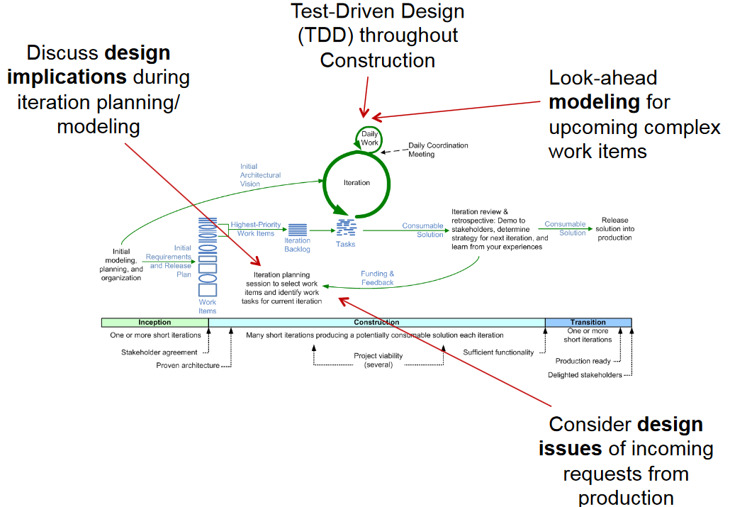

Emergent Design - Principles

Slide 37
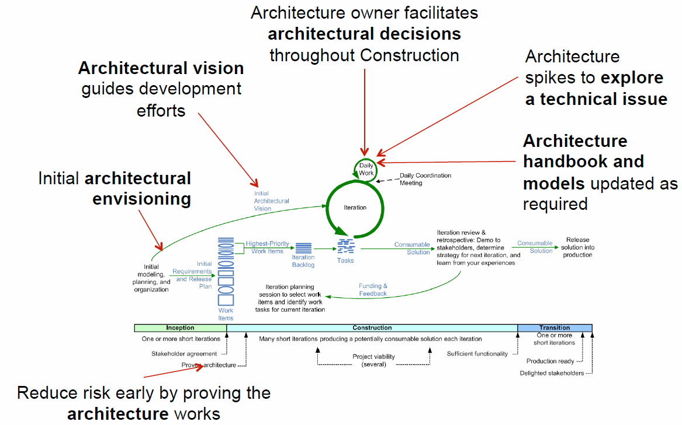
Continuous Architecture - PRinciples

Slide 38
How to organize your teams?

Slide 39
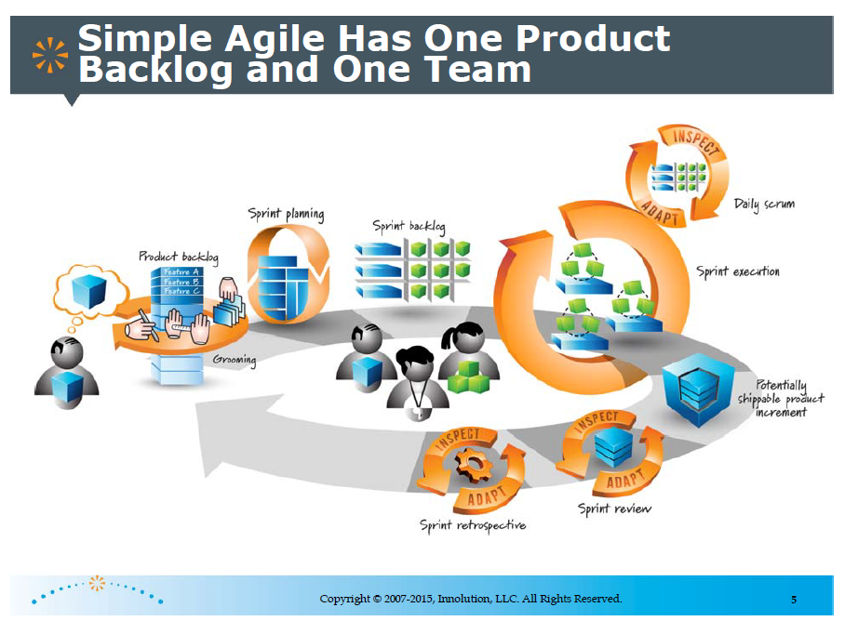
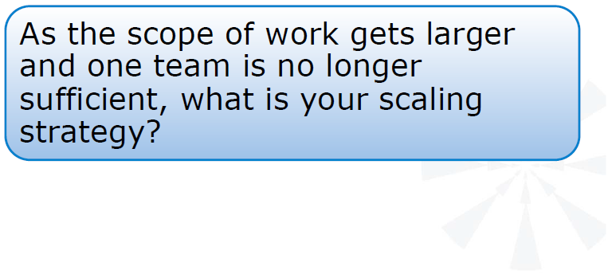

Slide 40
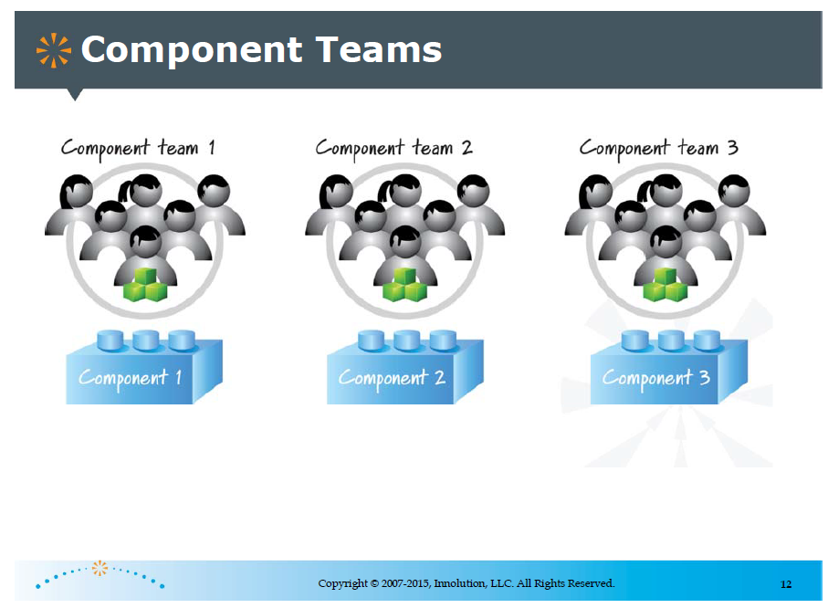

Slide 41
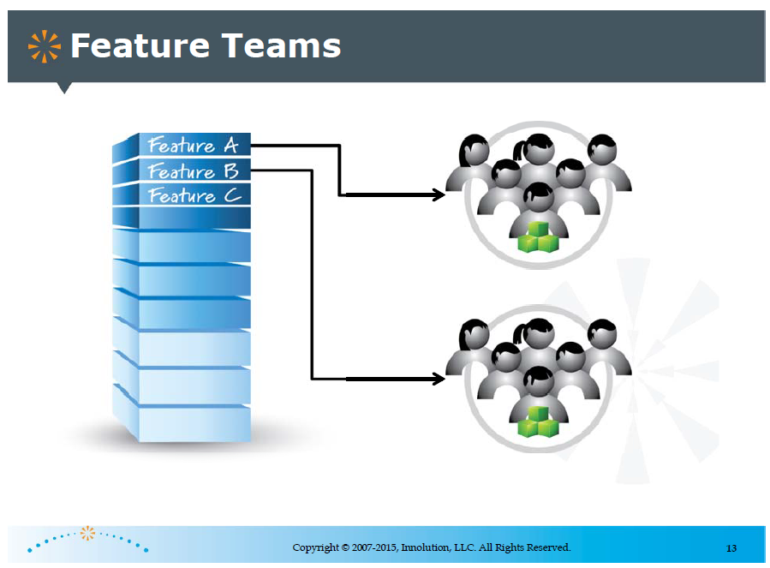

Slide 42
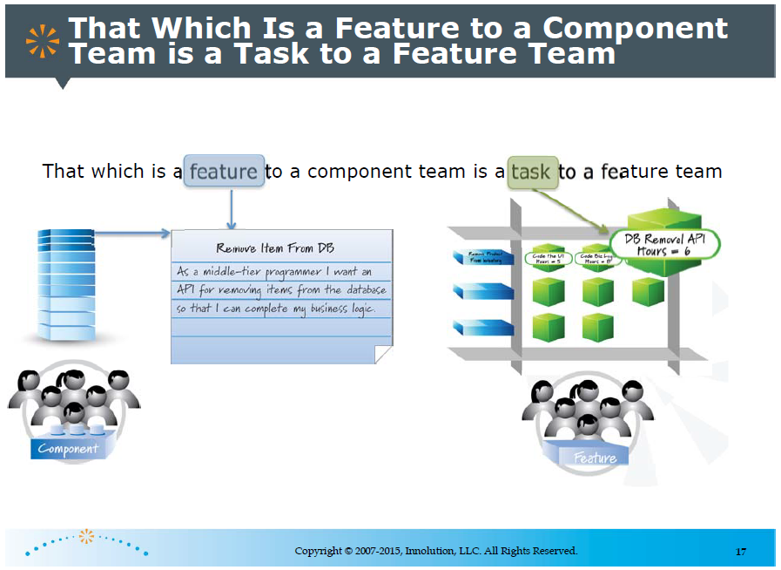

Slide 43
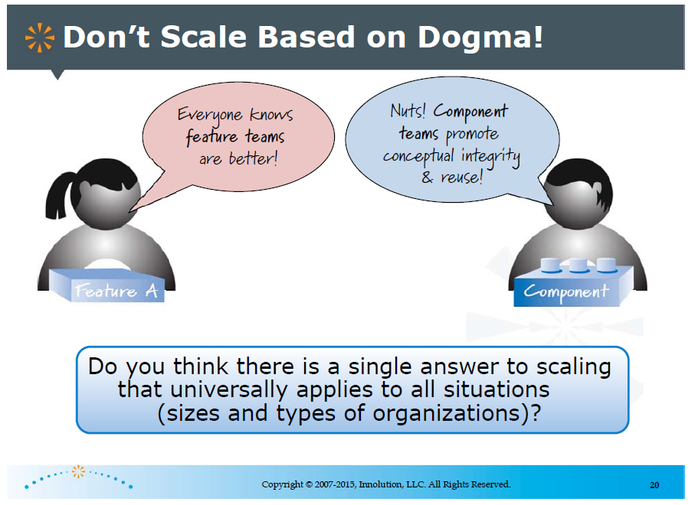

Slide 44


Conways LAW
”Organizations which design systems … are constrained to produce designs which are copies of the communication structures of these organizations”
Melvin Conway
”If you don’t want your product to look like your organization change your organization (or change your product)”
Rebecca Parsons, CTO Thoughtworks

Slide 45
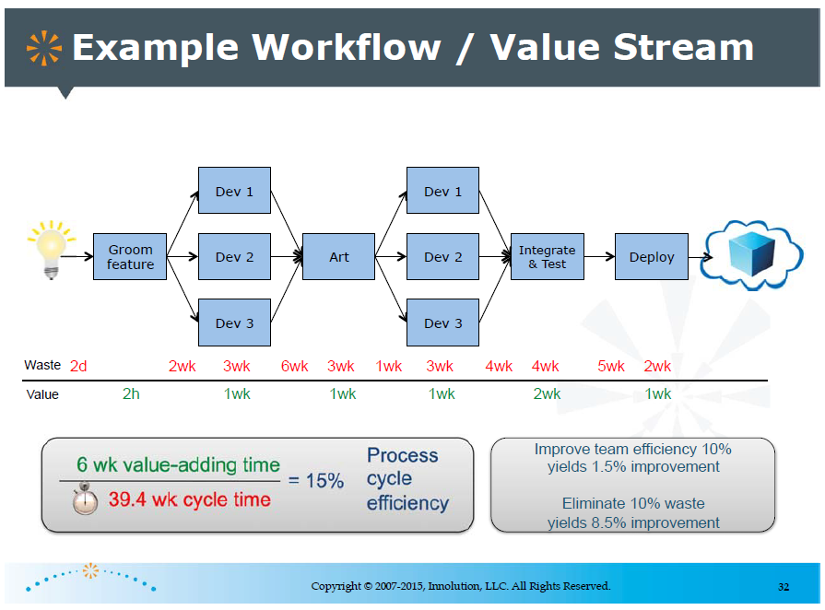

Slide 46
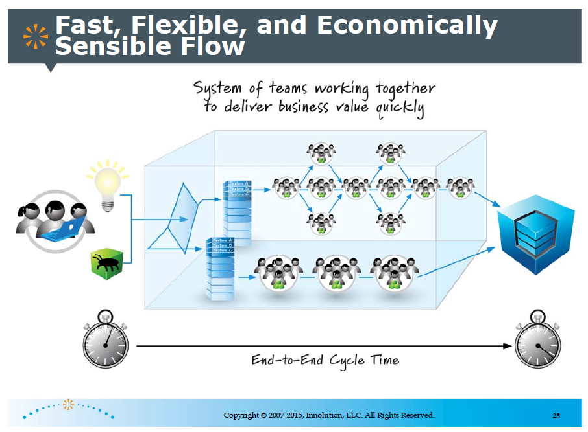

Slide 47
How to Architect for Continuous Delivery?

Slide 48
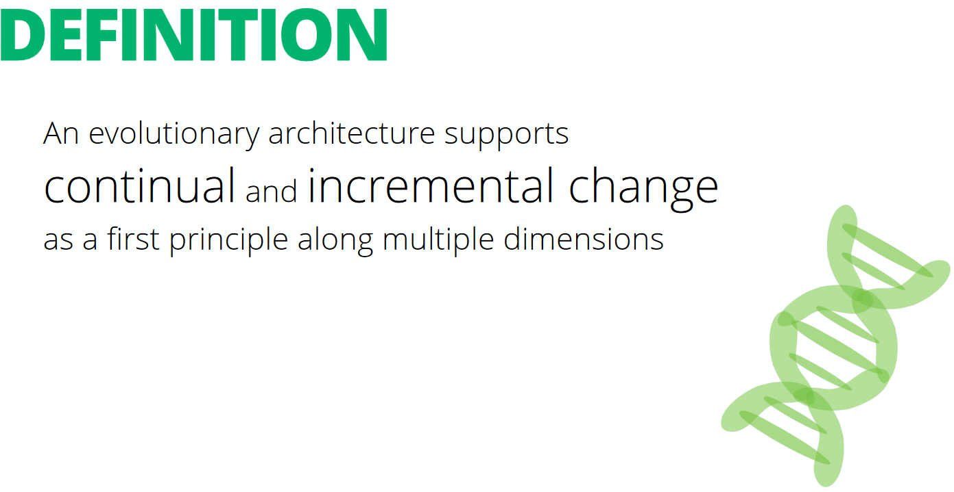

Evolutionary Architecture - Definition

Slide 49
Evolutionary Architecture
Fitness Function
We distinguish between emergent and evolutionary architecture, and this distinction is an important one. Much like in evolutionary computation techniques like genetic algorithms, an architectural fitness function specifies what our target architecture looks like.
Bring The Pain Forward
Inspired by the eXtreme Programming community. When something on a project has the potential to cause pain, force yourself to do it more often and earlier, which in turn encourages you to automate the pain away and identify issues early.
Last Responsible Moment
When decisions occur is a major distinction between traditional architecture and evolutionary architecture. In an evolutionary architecture, we wait for the last responsible moment to make decisions. The benefit of delaying a decision is the additional information available to make the decision.
Experimentation
Canary Releases, A/B Testing

Slide 50
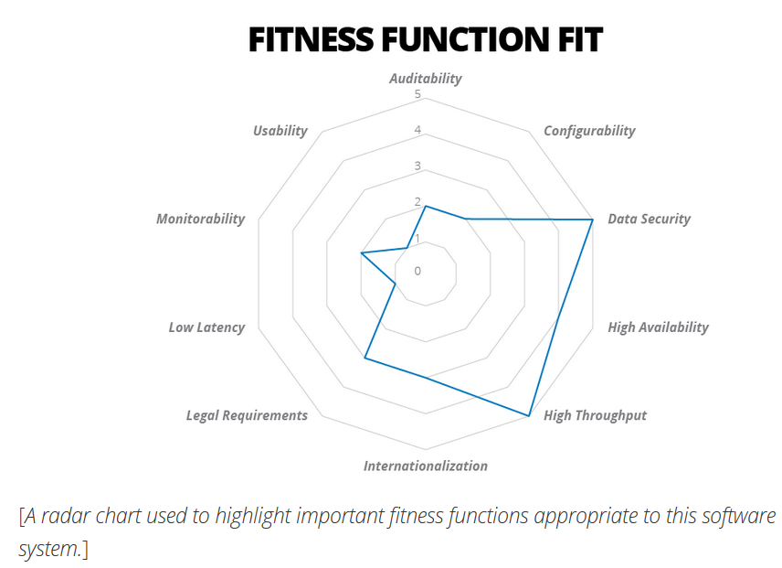
Fitness function
Much like in evolutionary computation techniques like genetic algorithms, an architectural fitness function specifies what our target architecture looks like. Some systems need high uptime while others are more concerned with throughput or security.
The up-front thinking about what the fitness function should be for a particular system provides the guidance for decision making and the timing of decisions. Architectural decisions are scored relative to the fitness function so that we can see that the architecture is evolving in the right direction.

Slide 51
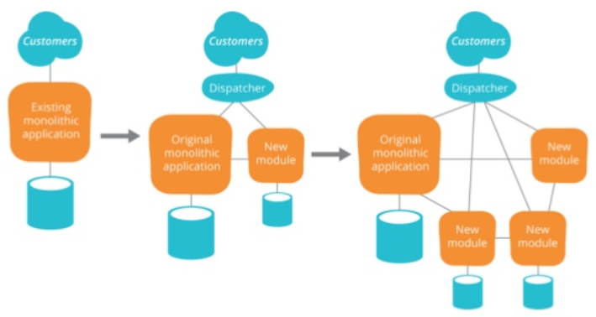
Strangler Pattern

Slide 52
Build or buy?

Slide 53
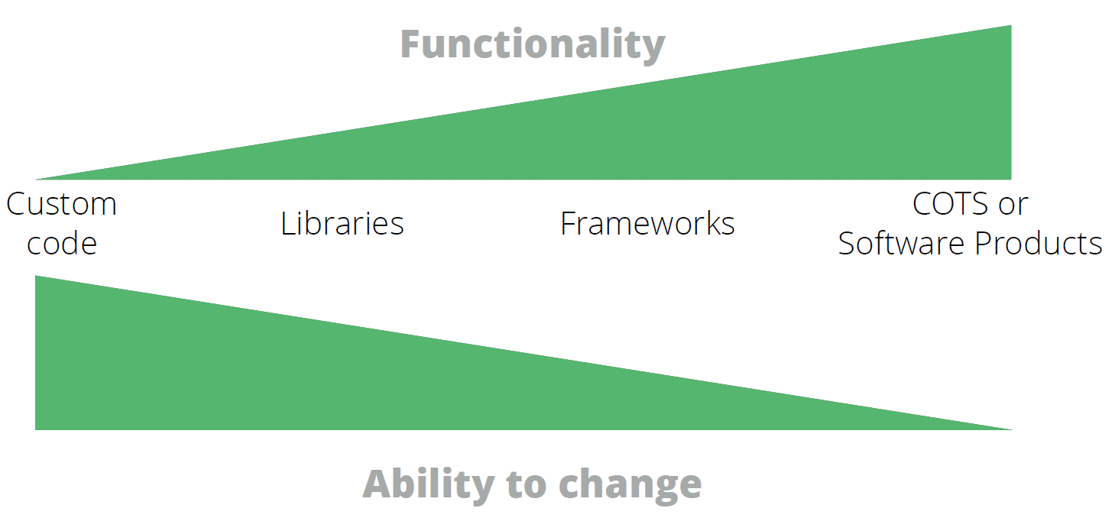
Build AND/or Buy
How much do you expect the system to change over time?

Slide 54
Are there more to functional decomposition than a reference model?

Slide 55
Validate Your Functional decomposition
Are your preferred decompositions testable?
How many teams need to be involved?
Can they encompass continuous delivery?
What about Conway’s Law?

Slide 56





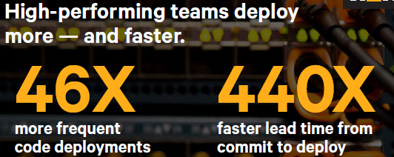
How Fast & proffessional Are your teams and systems
In which team(s) would you invest your money?

Slide 57
Thank You!

Slide 58
References
http://ronjeffries.com/xprog/articles/emergent-design/
https://www.thoughtworks.com/insights/blog/microservices-evolutionary-architecture
Continuous-Architecture-and-Emergent-Design-webinar Scott W. Ambler
Continuous Architecture Pierre Pureur, Murat Erder
Building Evolutionary Architectures Neal Ford (Rebecca Parsons & Patrick Kua)
Evolutionary Architecture (Patrick Kua)
https://pgppgp.wordpress.com/
http://www.disciplinedagiledelivery.com/ea-and-agile/
http://agilemanifesto.org/principles.html
http://agilemodeling.com/essays/agileArchitecture.htm#ArchitectureAtScale

Slide 59
Additional References
Why Scaling Agile doesn’t work - Jez Humble https://www.youtube.com/watch?v=2zYxWEZ0gYg
Architecting for Continuous Delivery – Jex Humble https://www.youtube.com/watch?v=_wnd-eyPoMo
Secrect of High Performance Teams – Jex Humble https://www.youtube.com/watch?v=EmDtmYwDs50&t=2243s
Mastering Chaos at Netflix https://www.youtube.com/watch?v=CZ3wIuvmHeM https://www.slideshare.net/JoshEvans2/mastering-chaos-a-netflix-guide-to-microservices

